Slide 1
Vancouver Convention Centre
Room Allocation

Slide 2
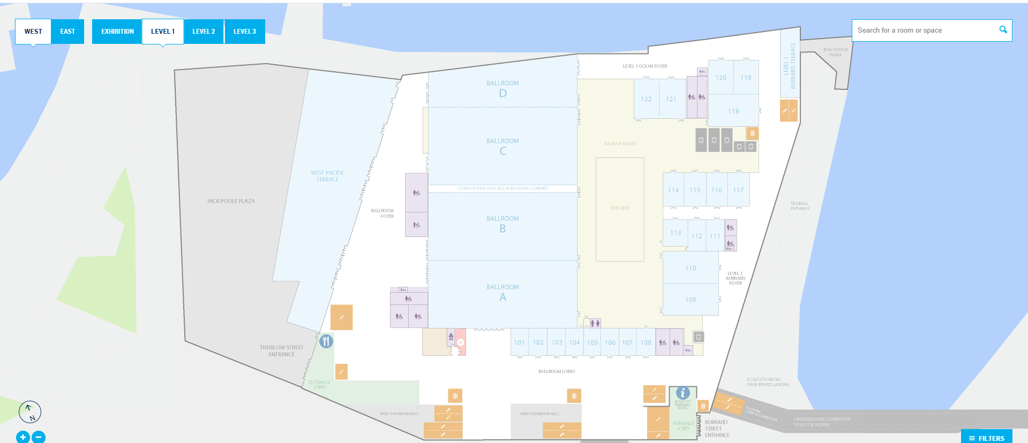
EXHIBIT HALL
SESSION ROOM 2
PLENARY ONE
SESSION ROOM 1
Registration

Slide 3
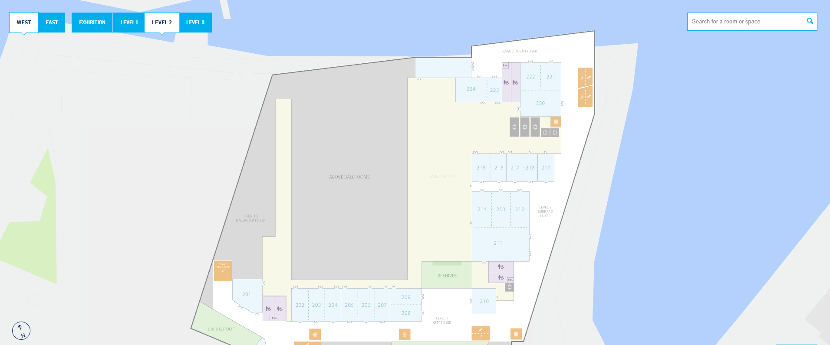
SESSION
ROOM 9
SESSION ROOM 10
SESSION
ROOM 8
SESSION
ROOM 6
SESSION ROOM 7
PLENARY TWO
SESSION ROOM 3
SESSION ROOM 4
SESSION
ROOM 5

Slide 4
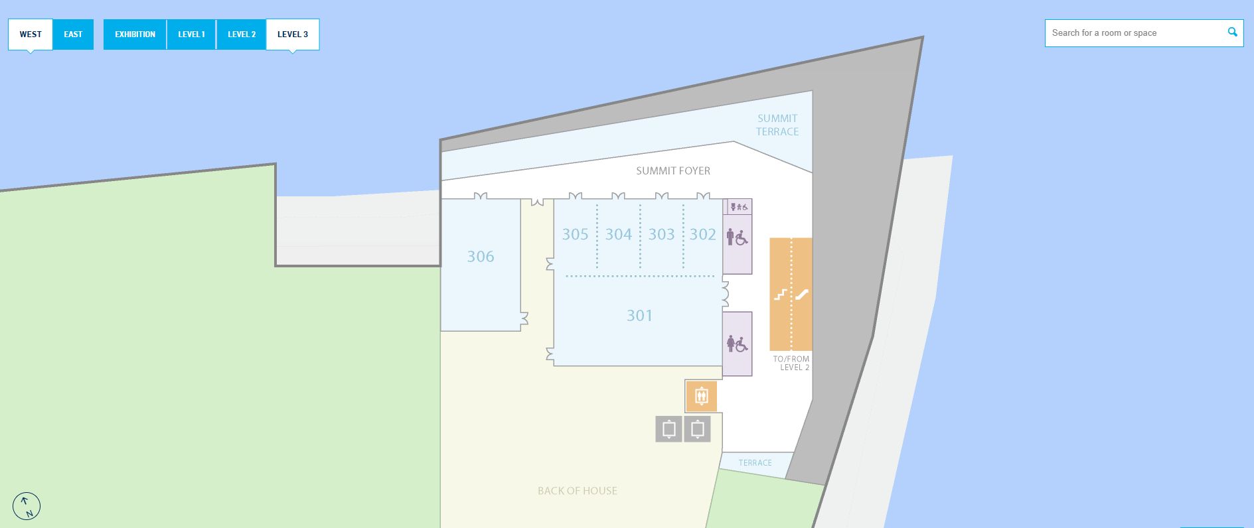
SESSION ROOM 12
SESSION ROOM 11

Slide 5
